Slide 1
Lending Club Case Study
Name: Ambareesh Balisetty & Nirmal Kumar

Slide 2
Objective & Goal
Objective :
To identify the risky loan applicants, reduce loans given to such persons and thereby cutting down the amount of credit loss.
Goals :
Understand the driving factors (or driver variables) behind loan default, i.e., the variables which are strong indicators of default.

Slide 3
Overall Loan Status Statistics
Loan status | Values | Percentage
Fully Paid | 32113 | 86%
Default | 5384 | 14%
Total | 37497 | 100%
On a total, 14% of the loans are being charged-off i.e., getting defaulted.

Slide 4
Impact Variables
S.No | Variable Name | Description | Difference between Default Loan Percentage between different groups
1 | int_rate | Interest Rate on the loan | 34.4%
2 | grade | LC assigned loan grade | 27.3%
3 | pub_rec_bankruptcies | Number of public record bankruptcies | 26.0%
4 | pub_rec | Number of derogatory public records | 22.4%
5 | home_ownership | The home ownership status provided by the borrower during registration | 18.8%
6 | purpose | A category provided by the borrower for the loan request. | 16.9%
7 | annual_inc | The self-reported annual income provided by the borrower during registration. | 16.7%
8 | term | The number of payments on the loan. Values are in months and can be either 36 or 60. | 14.3%

Slide 5
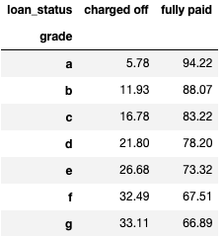
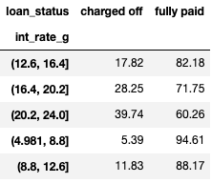
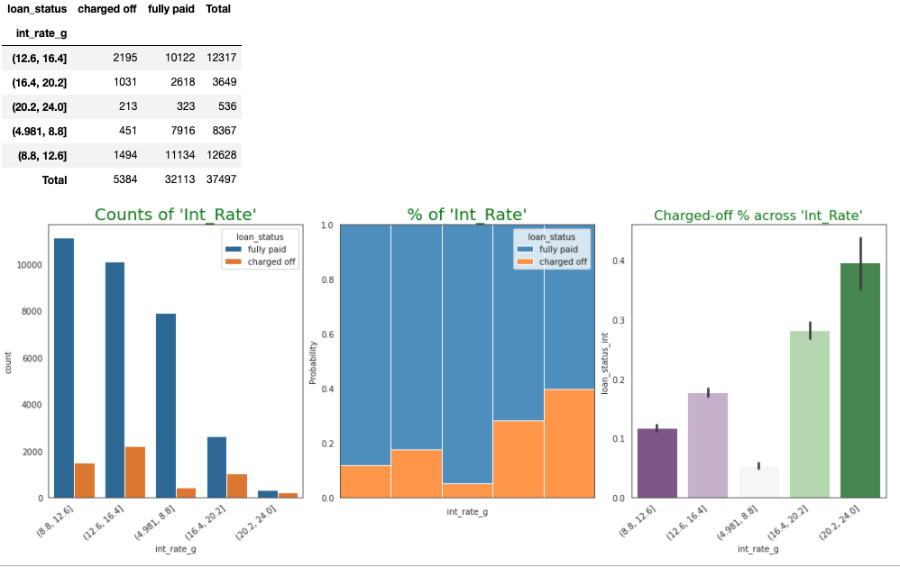
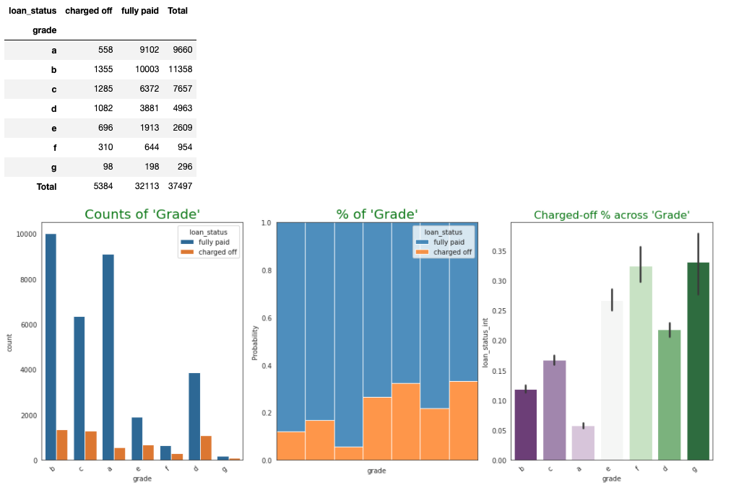
Loan Status against Interest Rate and Grade
Notes:
T

Slide 6
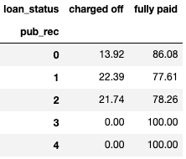
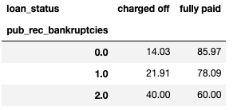
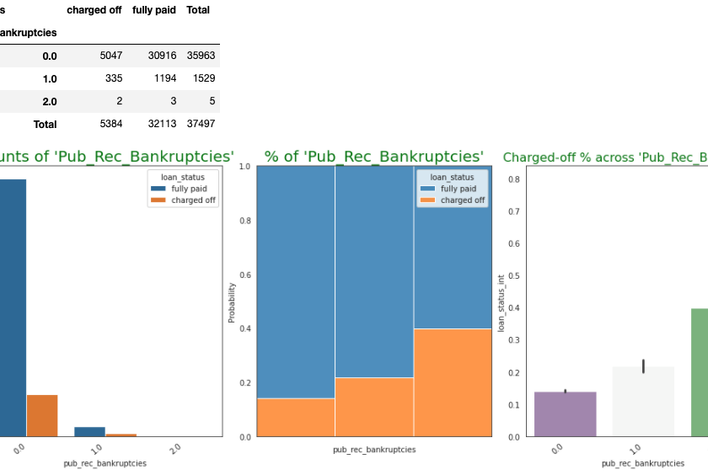
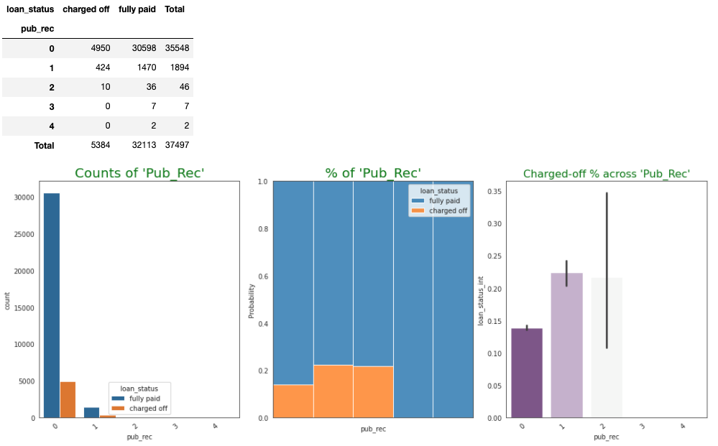
Loan Status against Bankruptcies and Derogatory Remarks
Notes:
T

Slide 7
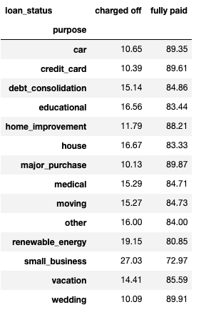
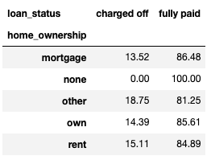
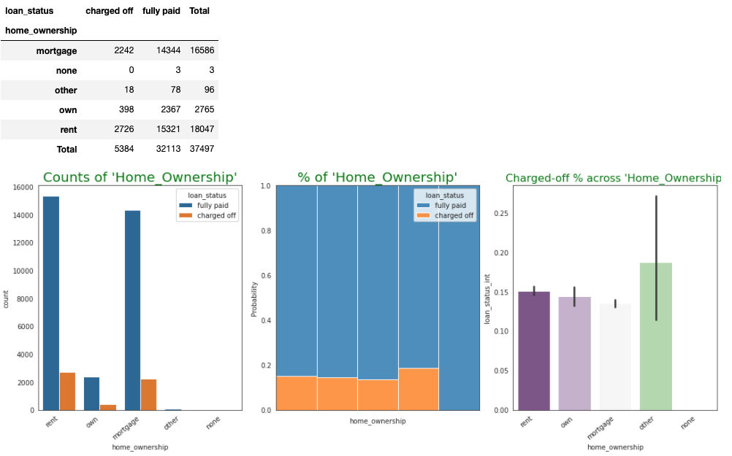
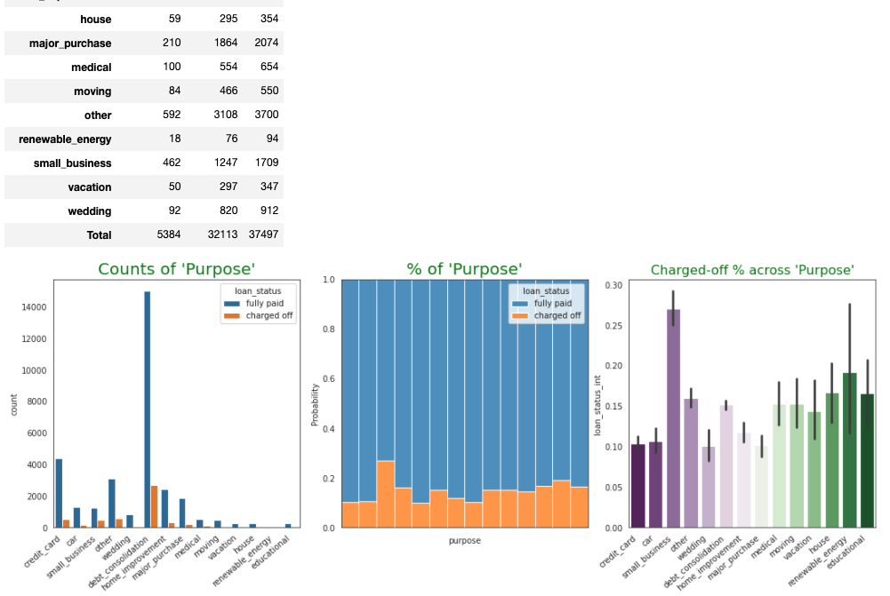
Loan Status against Home Ownership and Purpose
Notes:
T

Slide 8
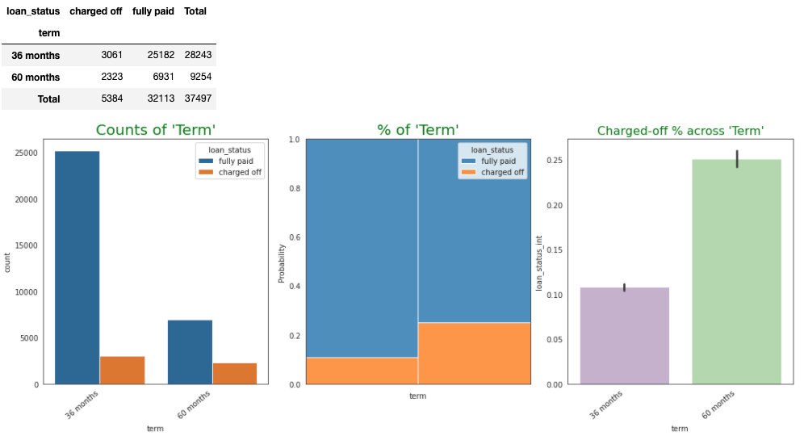
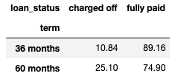
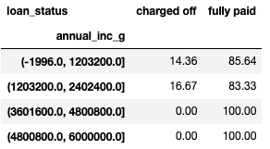
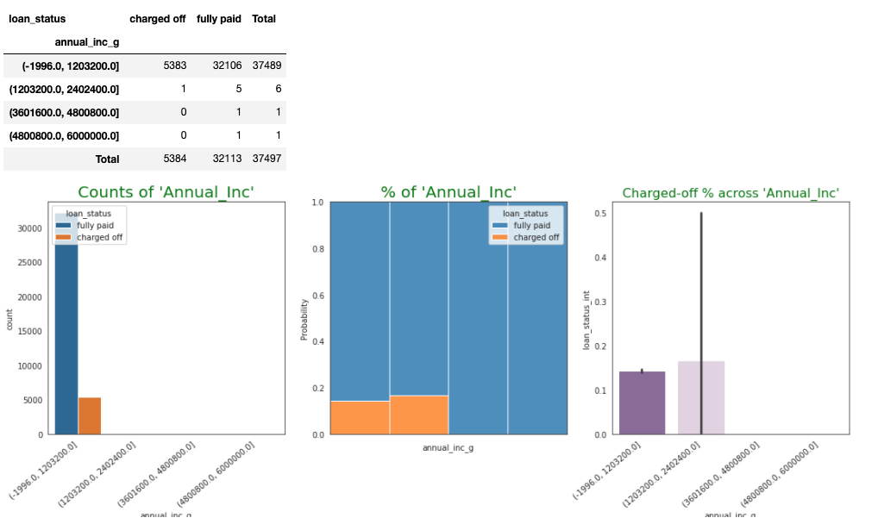
Loan Status against Term and Annual Income
Notes:
T

Slide 9
Primary Recommendations
Variable | Value | Default Rate
Interest Rate | 16% - 20% | 28%
 | 20% - 24 % | 40%
Term | 60 Months | 25%
Grades | D | 22%
 | E | 27%
 | F | 32%
 | G | 33%
Purpose | Small Business | 27%
Bankruptcies | 1 | 22%
 | 2 | 40$
Derogatory Remarks | 1 or 2 | 22%
Below recommendations are given when Default rate is set not to breach 22% :
Not to give loans having interest rates between 16 – 24 %.
Not to give loans having term as 60 months.
Not to give loans for the grades D, E, F and G
Not to give loans with purpose as ‘Small Business’
Not to give loans when the requestor is having bankruptcies or having one or two derogatory remarks.

Slide 10
Additional Recommendations - II
Independent Variable | Value | Dependent variable | Value | Default Rate
Grade | G | Derogatory Remarks | 1 | 66.7%
Grade | F | Home Ownership | Other | 50%
Grade | G | Home Ownership | Own | 50%
Grade | G | Purpose | Car | 50%
Grade | G | Purpose | House | 50%
Grade | G | Purpose | Medical | 66.67%
Grade | G | Bankruptcies | 1 | 66.67%
Below recommendations need to be followed when Default rate is set not to breach 50%.
Independent Variable | Value | Dependent variable | Value | Default Rate
Interest Rate | 16% - 20% | Grade | E | 50%
Interest Rate | 20% - 24% | Derogatory Remarks | 1 | 53%
Interest Rate | 20% - 24% | Home Ownership | Own | 60%
Interest Rate | 16% - 20% | Purpose | Educational | 66.7%
Interest Rate | 20% - 24% | Purpose | Educational | 66.7%
Interest Rate | 20% - 24% | Purpose | House | 50%
Interest Rate | 16% - 20% | Purpose | Medical | 57.1%
Interest Rate | 16% - 20% | Purpose | Small Business | 52.7%
Interest Rate | 16% - 20% | Bankruptcies | 1 | 54.8%
Independent Variable | Value | Dependent variable | Value | Default Rate
Term | 60 Months | Home Ownership | Other | 100%
Term | 60 Months | Annual Income | 12L - 24L | 100%
Derogatory Remarks | 1 | Home Ownership | Other | 66.67%
Derogatory Remarks | 2 | Purpose | Credit Card | 66.67%
Derogatory Remarks | 2 | Purpose | Medical | 50%
Home Ownership | Other | Purpose | Car | 50%

Slide 11
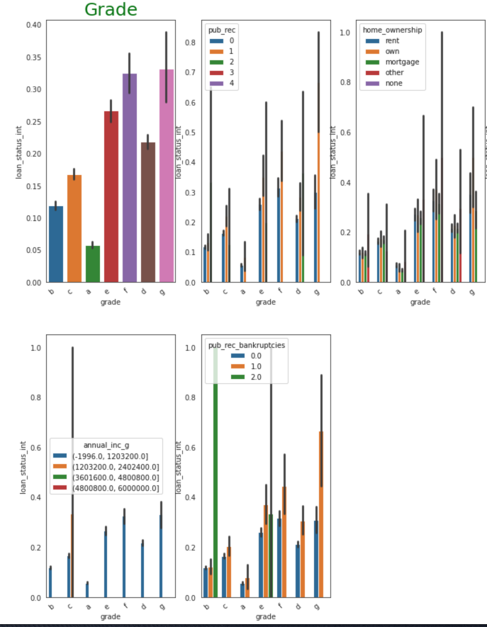
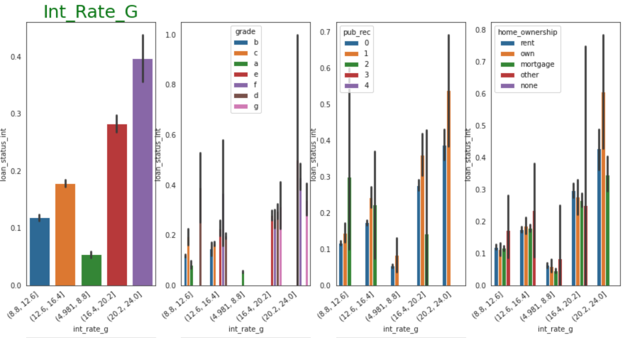
Additional Recommendations – II (Continued)
Below graphs shows the additional recommendations given for Interest and Grade variables

Slide 12
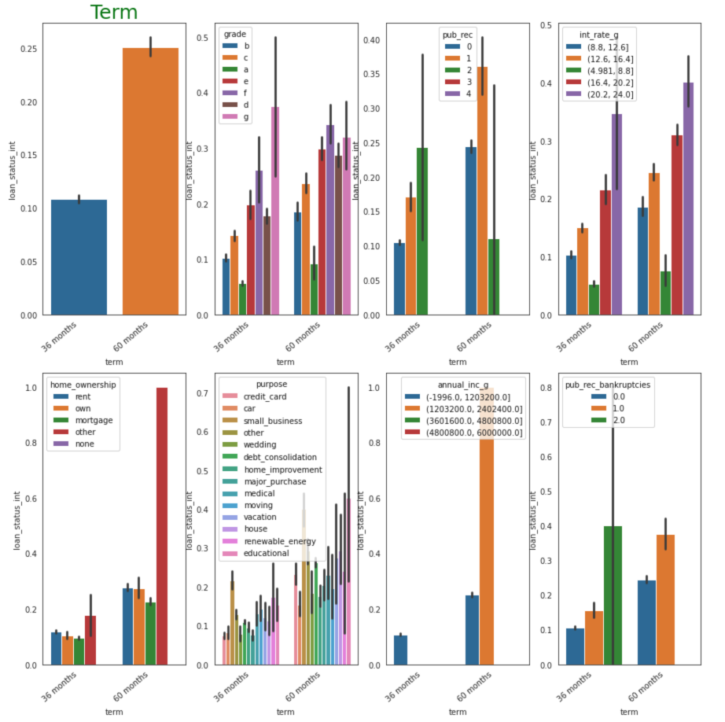
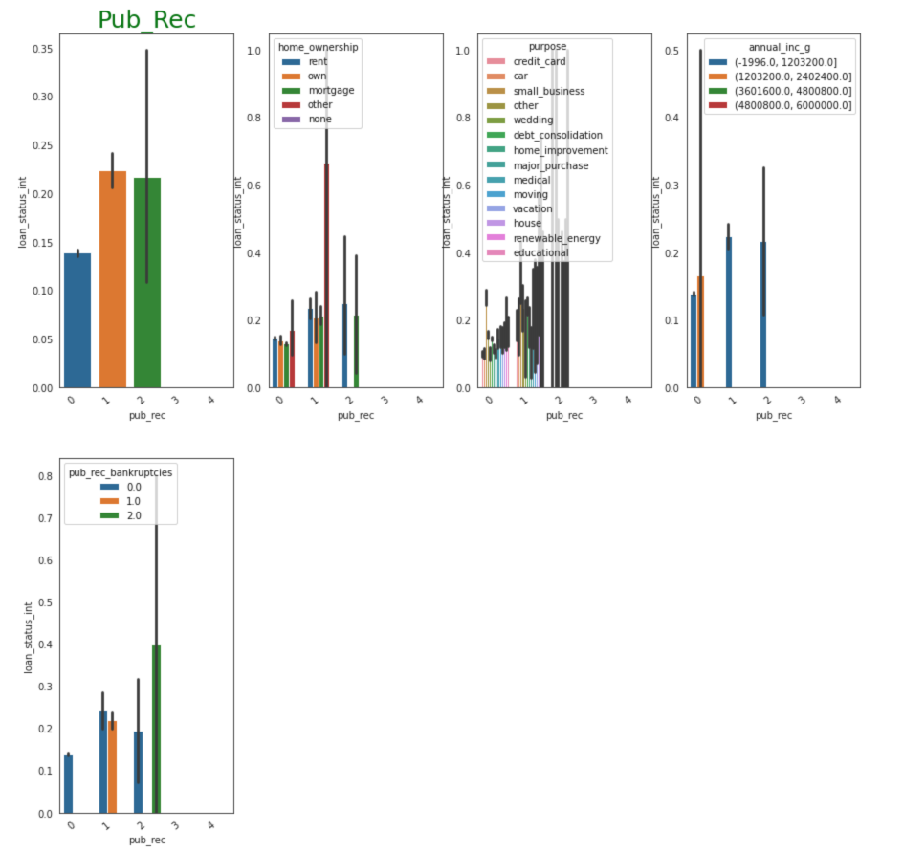
Additional Recommendations – II (Continued)
Below graphs shows the additional recommendations given for Term and Derogatory Remarks variables

Slide 13


